Slide 1
Sentiment Analysis Using LSTM
Student name :Albara Almeseidiyen
Supervised by
D. Mohammad Almseidin

Slide 2
Problem Overview
Objective: Automatically classify movie reviews as positive or negative
Importance: Real-world applications like feedback analysis, customer support, and content moderation

Slide 3
Dataset Description
Source: Kaggle
Description:CSV file with two columns (review, sentiment)
Size: (you specify based on your dataset)
Balanced
Label encoding: positive → 1, negative → 0

Slide 4
Text Preprocessing
Tokenization using Keras Tokenizer
Maximum vocabulary size: 10,000
Padding: Max length = 200 tokens
Label encoding using sklearn’s LabelEncoder

Slide 5
Model Architecture
Layer (type) | Output Shape | Param
Embedding | (64, 200, 64) | 640,000
LSTM | (64, 64) | 33,024
Dense | (64, 1) | 65
Embedding layer: 64-dimensional
LSTM layer with 64 units
Dense layer with sigmoid activation
Binary output (0: negative, 1: positive)

Slide 6
Training Configuration, Performance Metrics
Optimizer: Adam
Loss Function: Binary Crossentropy
Epochs: 10
Batch Size: 64
Validation Split: 20%
Accuracy on test data: ~85%Loss
accuracy curves over epochs
Confusion matrix

Slide 7
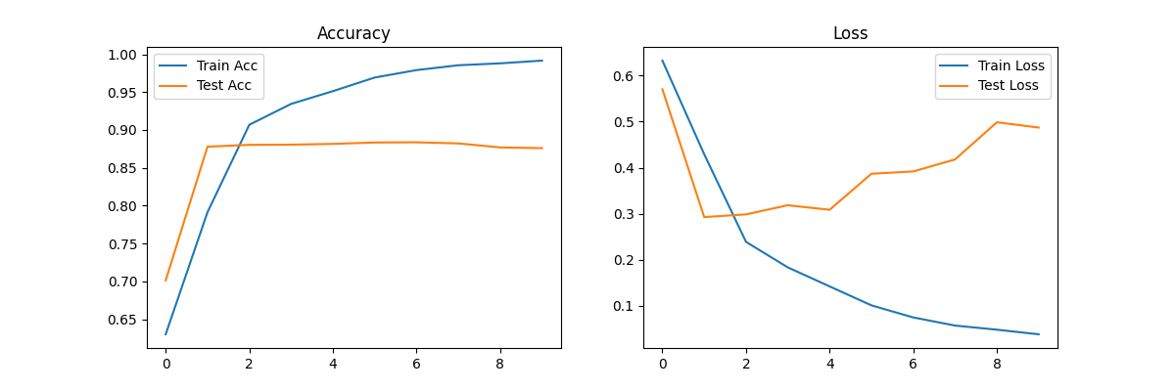
Results

Slide 8
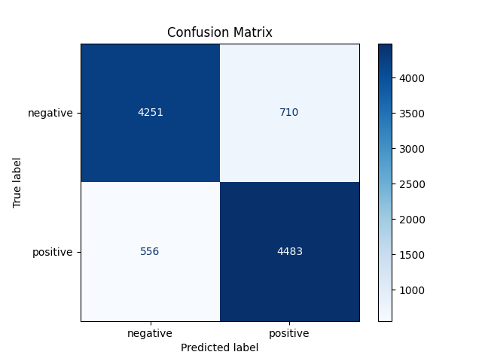
Results
accuracy on test data: 87.77%

